Slide 2
Crisis Response and Diversion Margarita Chavez-Sanchez, Director Department of Behavioral Health Services

Slide 3
2014 Ballot Question

Slide 4
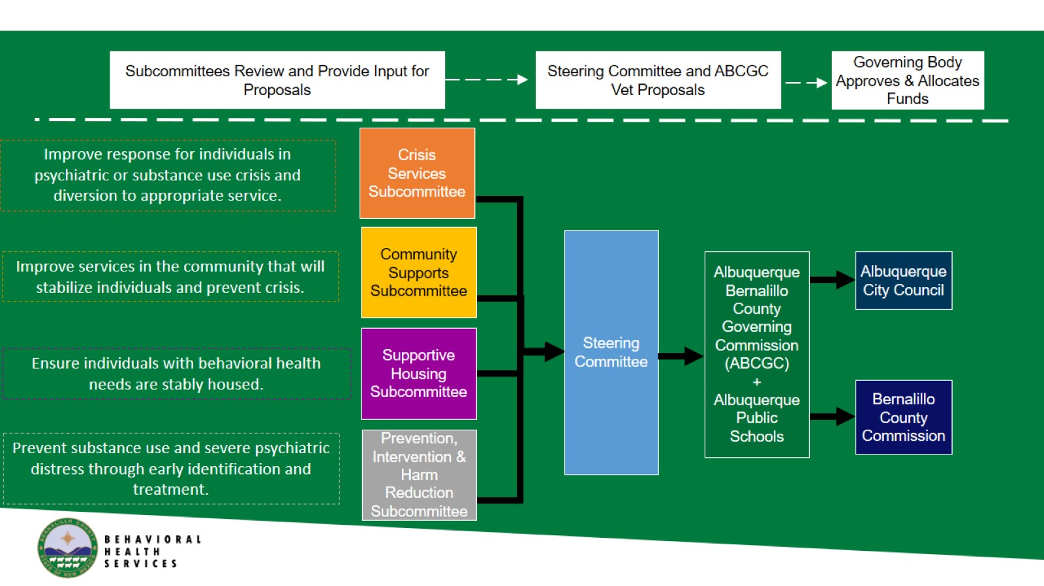

Slide 5
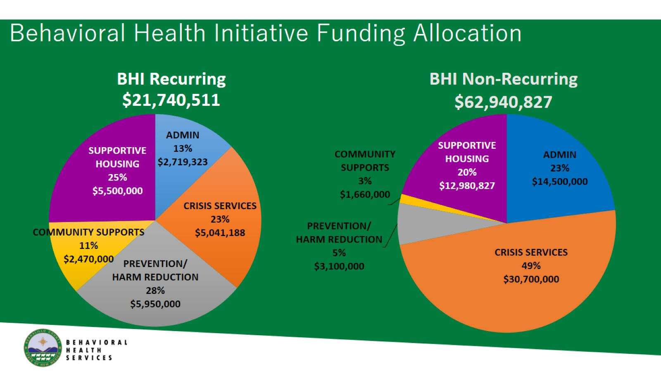
BHI Recurring $21,740,511

Slide 17
Douglas County, KS

Slide 18
We are going to build a crisis center…

Slide 19
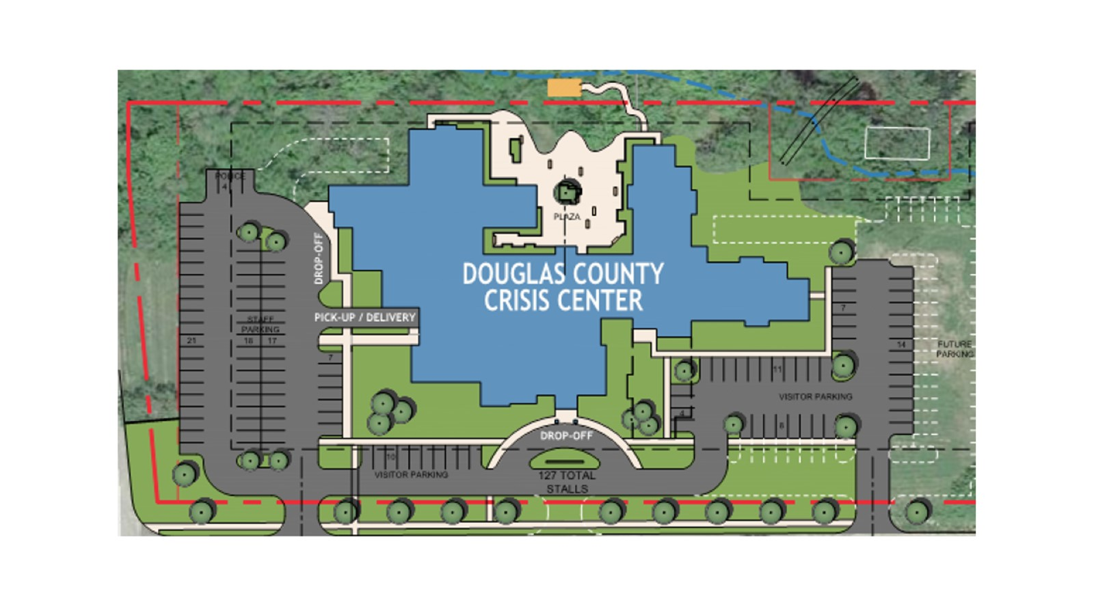

Slide 20
System-wide Focus

Slide 21
Establish Planning Team

Slide 24
Douglas County Continuum of Care

Slide 25
Data Gathering

Slide 26
Prioritization of Next Steps

Slide 27
City of Baltimore 911 Diversion Pilot

Slide 35
Yavapai Law Enforcement Mental Health Learning Site Collaboration

Slide 36
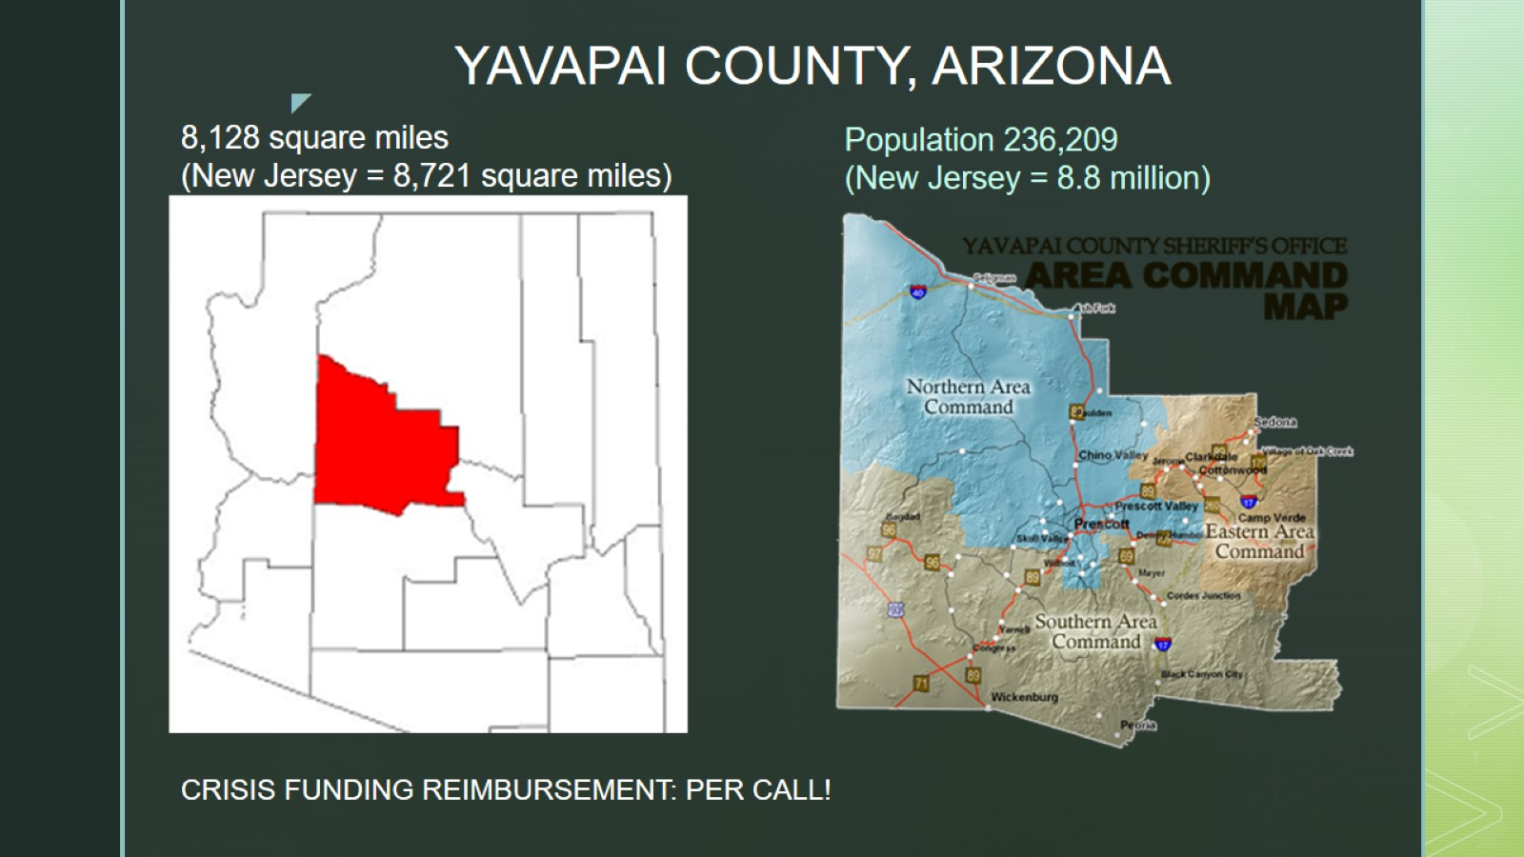
YAVAPAI COUNTY, ARIZONA

Slide 38
ELEMENTS OF A STRONG PRE-ARREST DIVERSION

Slide 40
12-Month Snapshot

Slide 42
Additional Countywide Partners

Slide 43
CROSS-SYSTEM DATABASE

Slide 44
NEXT STEP: 911 DEFLECTION through Spectrum Healthcare Group

Slide 45
Beya.Thayer@yavapaiaz.us 928.554.8820

