Slide 2
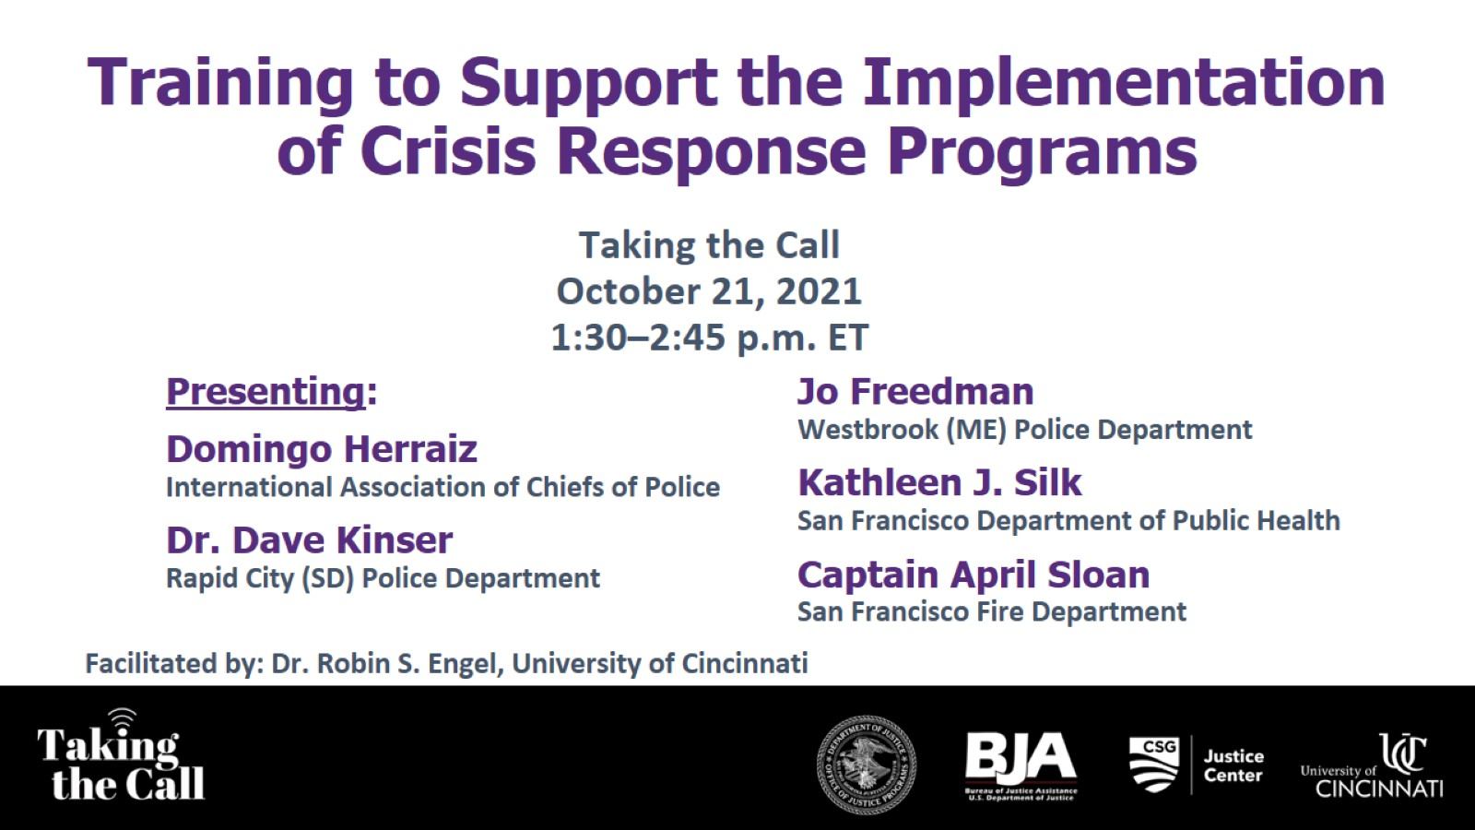
Training to Support the Implementation of Crisis Response Programs

Slide 3
Introducing Our Speakers

Slide 4
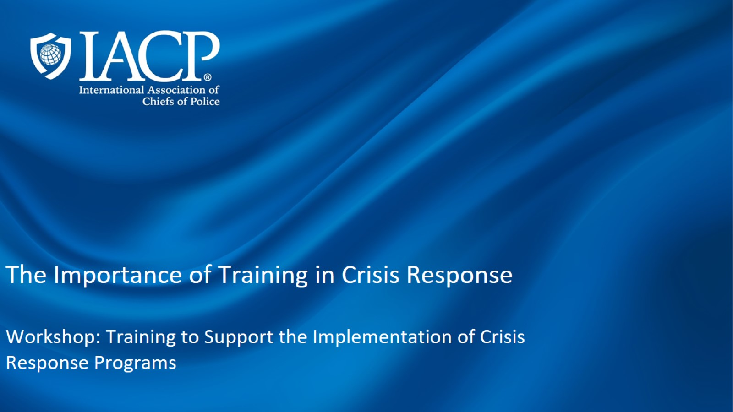
The Importance of Training in Crisis Response Workshop: Training to Support the Implementation of Crisis Response Programs

Slide 5
International Association of Chiefs of Police (IACP)

Slide 9
Academic Training to Inform Police Responses:

Slide 11
Develop, Pilot, and Evaluate

Slide 12
Academic Training Pilots

Slide 13
Academic Training Tools and Resources

Slide 15
One Mind Initiative

Slide 16
TTA specific to Crisis Response related to Substance Use

Slide 17
By the field, for the field

Slide 18
About the CRI-TAC

Slide 19
CRI-TAC TTA Overview

Slide 20
Request CRI-TAC Assistance in Crisis Response

Slide 21
Introducing Our Speakers

Slide 22
RCPD MISSION AND VISION

Slide 23
COLLECTIVE HEALING INITIATIVE

Slide 24
TRAUMA AND CRISIS INFORMED POLICING TRAINING

Slide 25
CO-RESPONSE AND TRAUMA

Slide 26
CO-RESPONSE FRAMEWORK AND VISION

Slide 27
OFFICER WELLNESS AND PEER SUPPORT

Slide 28
COORDINATED YOUTH OUTREACH

Slide 29
THANK YOU

Slide 30
Introducing Our Speakers

Slide 31
CO-RESPONSE

Slide 32
CO-RESPONSE

Slide 33
INTEGRATING INTO A POLICE DEPARTMENT

Slide 34
IMPLEMENTING A PROGRAM

Slide 35
FOLLOW-UP

Slide 36
PATIENCE: ADVOCATES FOR INDIVIDUALS AND THE SYSTEM

Slide 37
Introducing Our Speakers

Slide 38
Introducing Our Speakers

Slide 39
STREET CRISIS RESPONSE TEAM

Slide 40
Background

Slide 41
Key Elements of Crisis Systems

Slide 42
Street Crisis Response Team Goal and Strategies

Slide 43
Program Details

Slide 44
Team Training

Slide 45
Data Themes

Slide 46
Thank You

Slide 47
Question & Answer

