Slide 2
Applying a Race Equity Lens When Implementing Crisis Response Programs
Kirby Gaherty & Tony McCright, National League of Cities
Anthony Cooper and Assistant Chief John Patterson, Madison, WI
Council Vice President Willie Lightfoot, Rochester, NY
Lena Hackett, Indianapolis, IN

Slide 3
Setting the Tone
Local Crisis Response and Equity
Reimagining Public Safety
National League of Cities
Justice Initiatives
Race, Equity, and Leadership

Slide 4
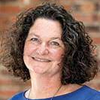
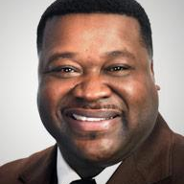
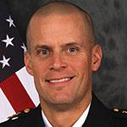
Introductions

Slide 5
Local Crisis Response Programs

Slide 6
Madison, Wisconsin Focused Interruption and Madison Police Department
Collaborative community responder projects
Outreach
Community Safety Workers

Slide 7
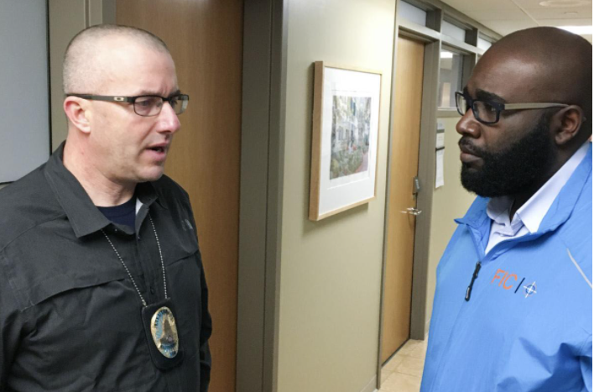
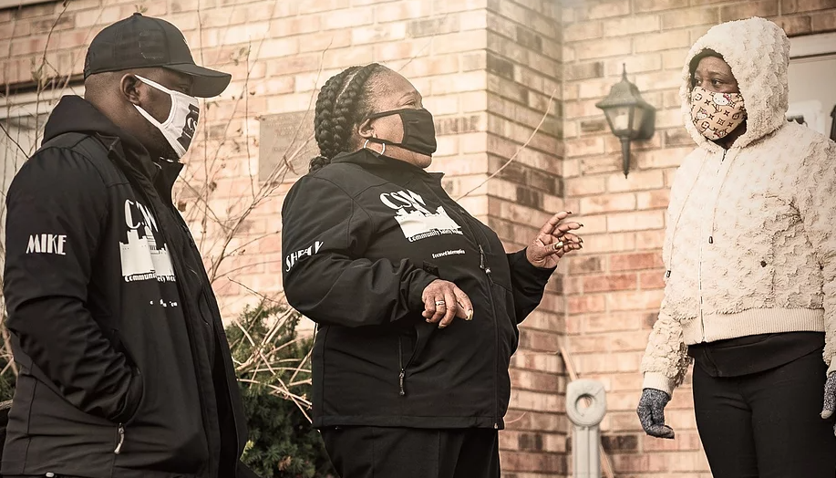
Madison, Wisconsin Focused Interruption and Madison Police Department
Outreach
Peaceful conflict resolution (diffusing violence)
Connection to social services
Build community
Facilitate healing
Community Safety Workers
Low-level conflict response and disruption
Reducing police response through collaboration and partnership
Strengthening neighbors and neighborhoods
Use of police incident data
Connecting people who share similar lived experiences

Slide 8
Rochester, NY—Crisis Intervention Services
Person in Crisis (PIC) Team
Launched in January 2021—non-police response
Goal—Create a comprehensive, community-based response to support victims and families dealing with homicides, mental health, domestic violence, and other related crises
Removed crisis response from the police department
Formerly FACIT, a crisis response team based within the PD
This allows collaboration with but not reliance on police

Slide 9
Rochester, NY—Crisis Intervention Services: Why?
Death of Daniel Prude launched drastic changes
City responded with various reform and transformation plans
Crisis response among the most important changes
Equity at the core

Slide 10
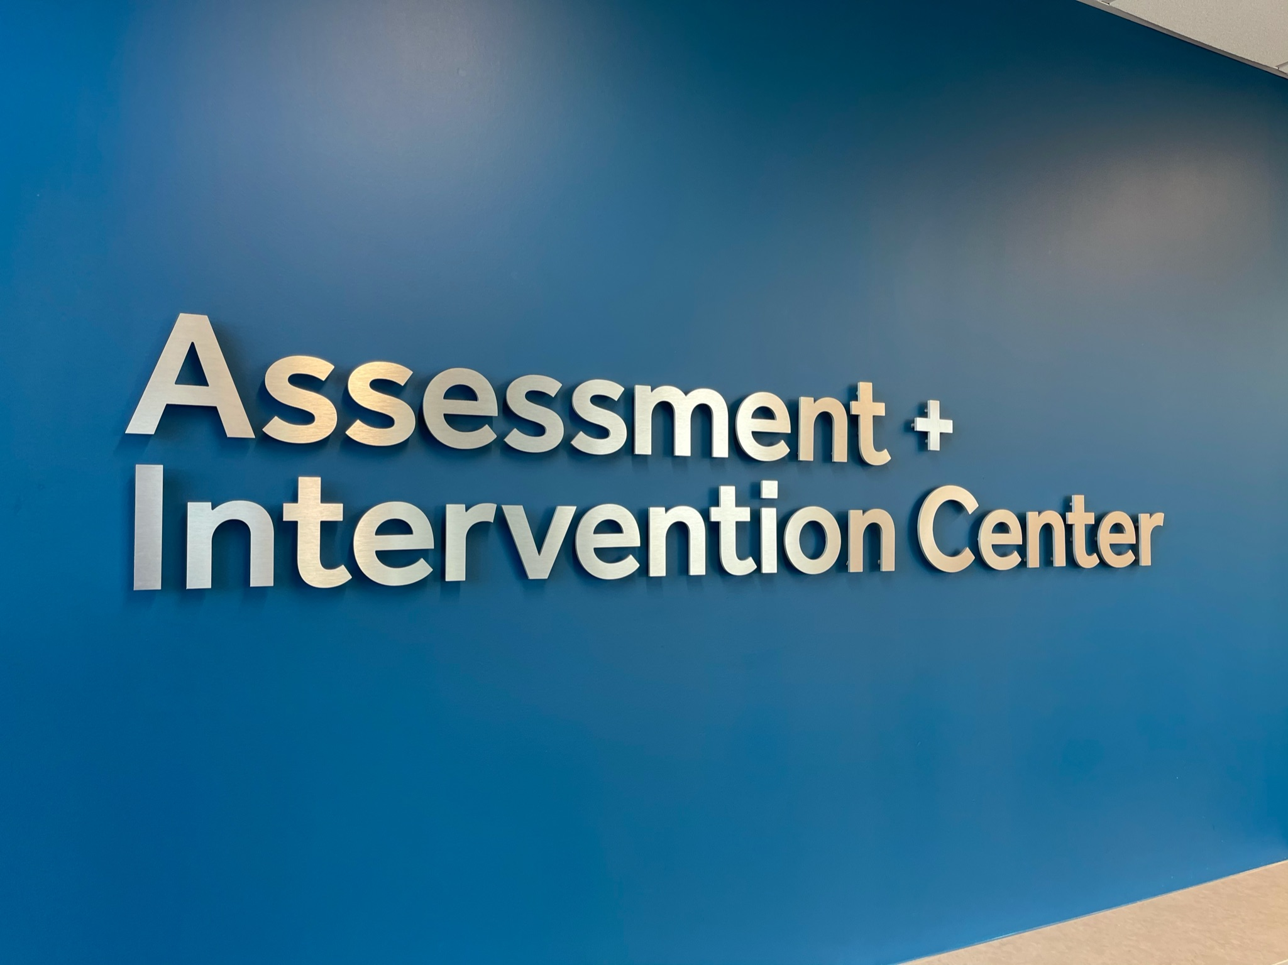
Marion County/Indianapolis

Slide 11
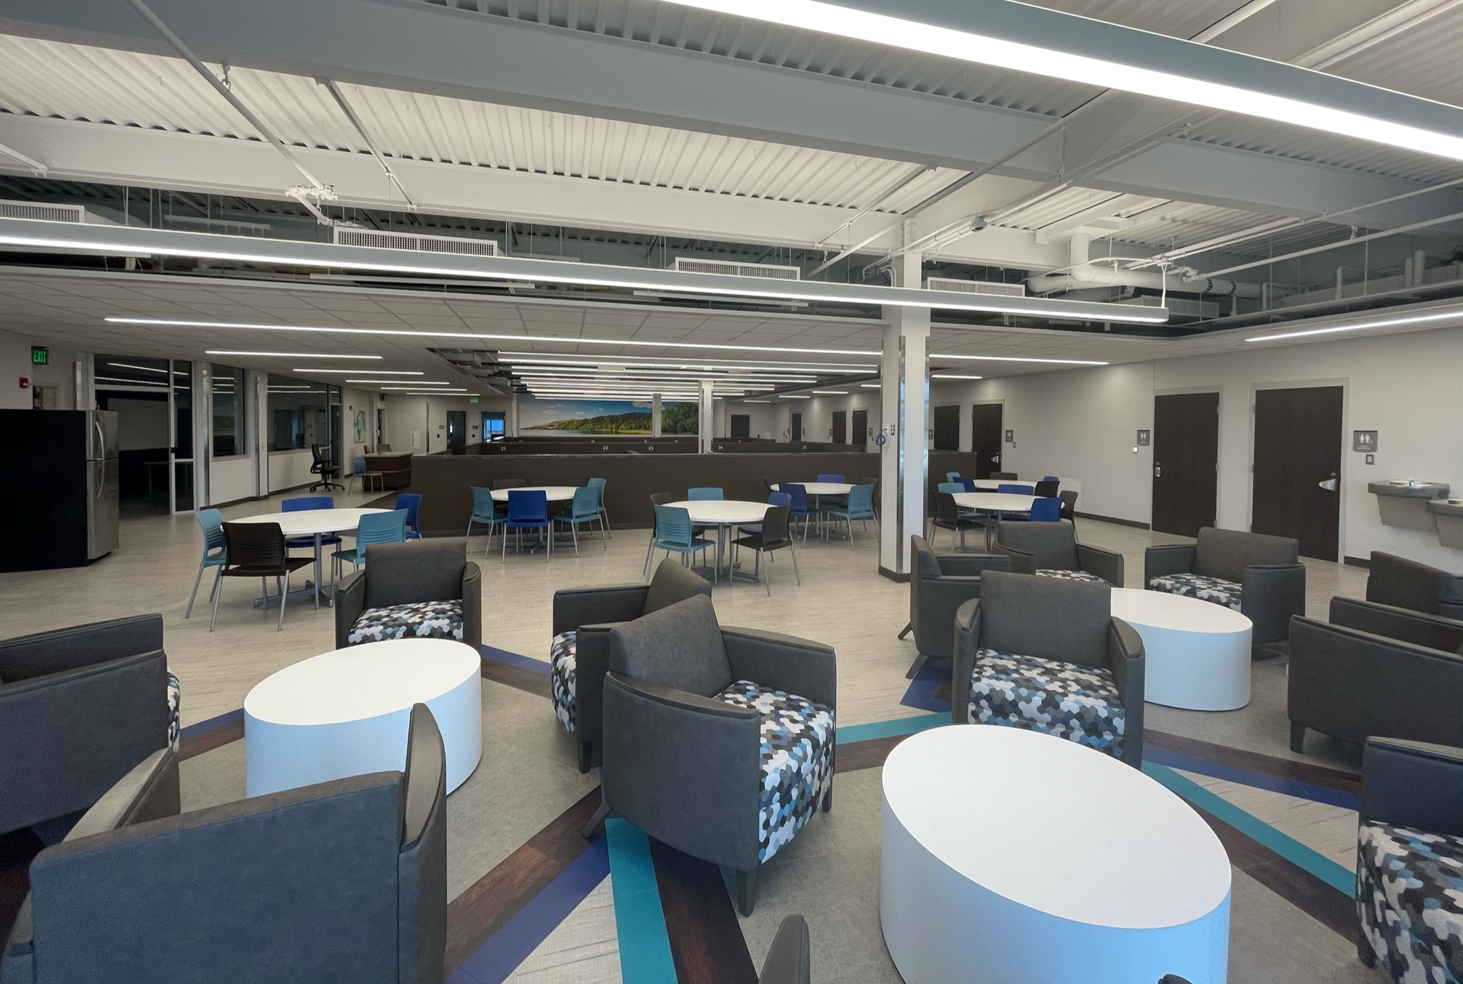
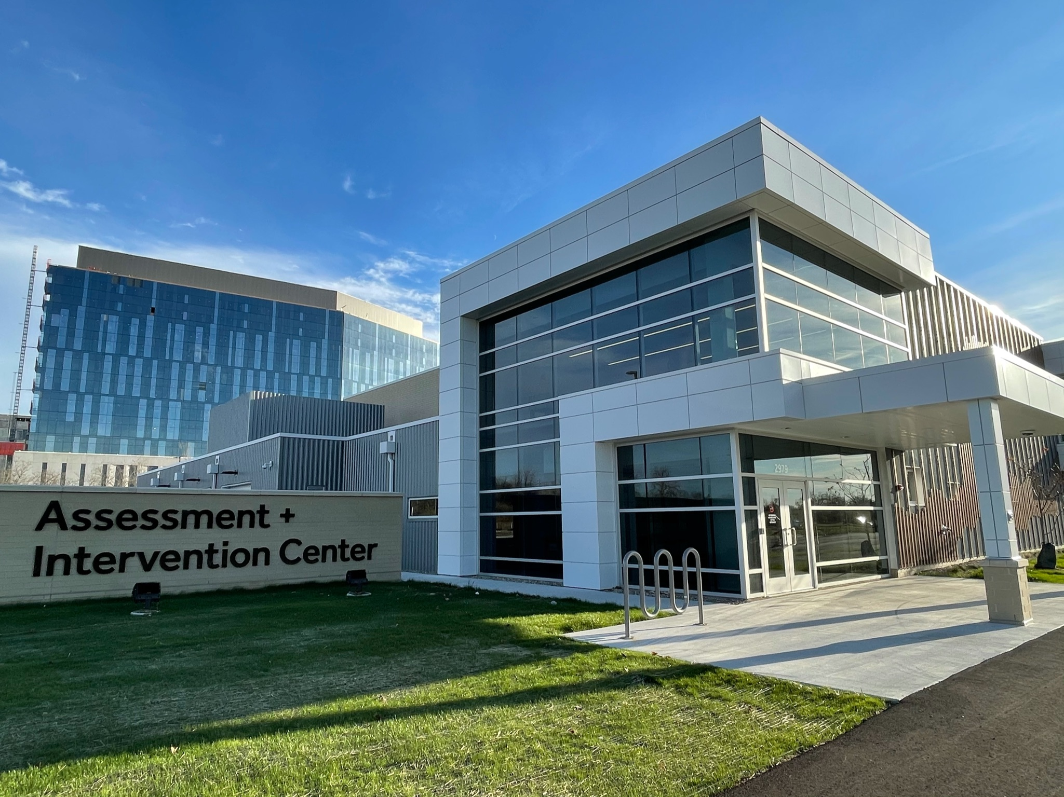
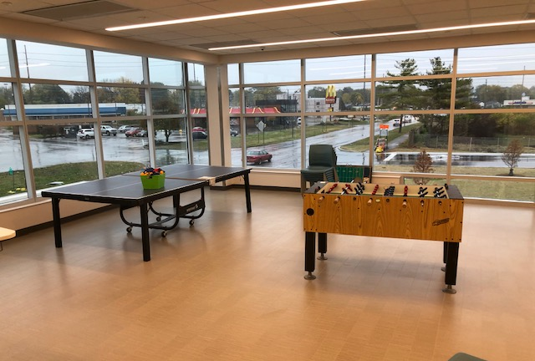

Slide 12
AIC Substance Use Self-Reported Data August 2021
Alcohol = the most commonly reported primary (36%) followed by opioids (29%) Stimulants = the most common secondary (35%) followed by canniboids (26%)

Slide 13
AIC Behavioral Health Self-Reported Data August 2021
Behavioral Health
Top 4 Self-Reported Issues:
Depression (28%)
Anxiety (23%)
Bipolar Disorder (19%)
Schizophrenia Spectrum (15%)

Slide 14
AIC Gender and Race Data March 2021 through August 2021
Referral vs Discharge | Black or African-American | White | Asian or Pacific Islander | Native American or Alaskan Native | Other | Unidentified | TOTAL
Male | 208 | 472 | 4 | 1 | 9 | 173 | 867
Female | 83 | 172 | 1 | 3 | 10 | 70 | 339
Transgender Female | 1 | 2 | 0 | 0 | 1 | 0 | 4
Gender non-conforming | 0 | 0 | 0 | 0 | 0 | 0 | 0
Unidentified gender | 1 | 7 | 0 | 0 | 2 | 41 | 51
TOTAL REFERRAL | 293 | 653 | 5 | 4 | 22 | 284 | 1261
Male | 152 | 332 | 3 | 0 | 6 | 105 | 598
Female | 52 | 116 | 1 | 2 | 8 | 43 | 222
Transgender Female | 0 | 1 | 0 | 0 | 1 | 0 | 2
Gender non-conforming | 0 | 0 | 0 | 0 | 0 | 0 | 0
Unidentified gender | 1 | 4 | 0 | 0 | 2 | 4 | 35
TOTAL ADMISSIONS (Unique clients) | 205 | 453 | 4 | 2 | 17 | 176 | 857

Slide 16
AIC Admissions – Gender and Race March 2021 through August 2021

Slide 17
Racial Demographics in the Jail June 30, 2018 vs. December 31, 2019
100%
80%
60%
60%
52%
40%
46%
39%
20%
1%
2%
0%
6/30/2018
12/31/2019
Black
White
Other
Source: BKD Report (2020)

Slide 18
AIC Latinx Data (Identifying as Hispanic Ethnicity) March 2021 through August 2021

Slide 19
Race of Clients Served by the AIC at Least Once

Slide 20
www.communitysolutionsinc.net
Lena Hackett, MPH
lena@communitysolutionsinc.net
Notes:
The work takes discipline.. Our tendency is to lead with strategy. In this framework you have to know what “ends” you are working to achieve before you begin the “means” to get there. The work of the MCRC has resulted in a steady decline in the return to incarceration and the rearrest rates. It has also resulted in deep relationships between service providers and criminal justice providers, and across criminal justice agencies. Marion County has a “new normal” – partners trust each other, they collaborate with each other, and it is natural behavior to work together.
Rhiannon could give examples

Slide 21
Moderated Conversation: Challenges, Wins, and Equity

Slide 22
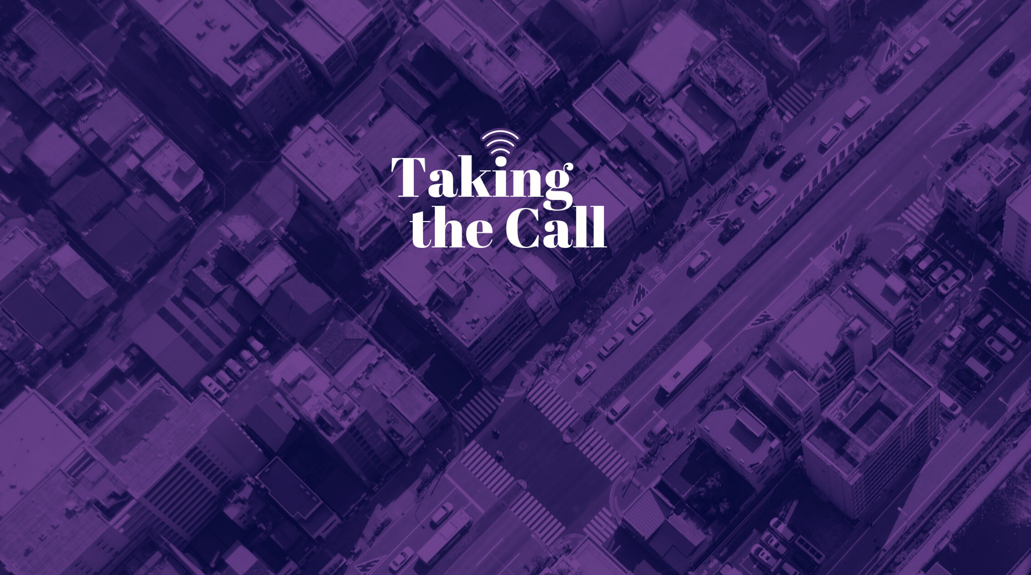
Thank You!
Risë Haneberg at rhaneberg@csg.org

