Slide 2
Background and Focus Population
Ashley Krider, Senior Project Associate II, Policy Research Associates, Inc.

Slide 3
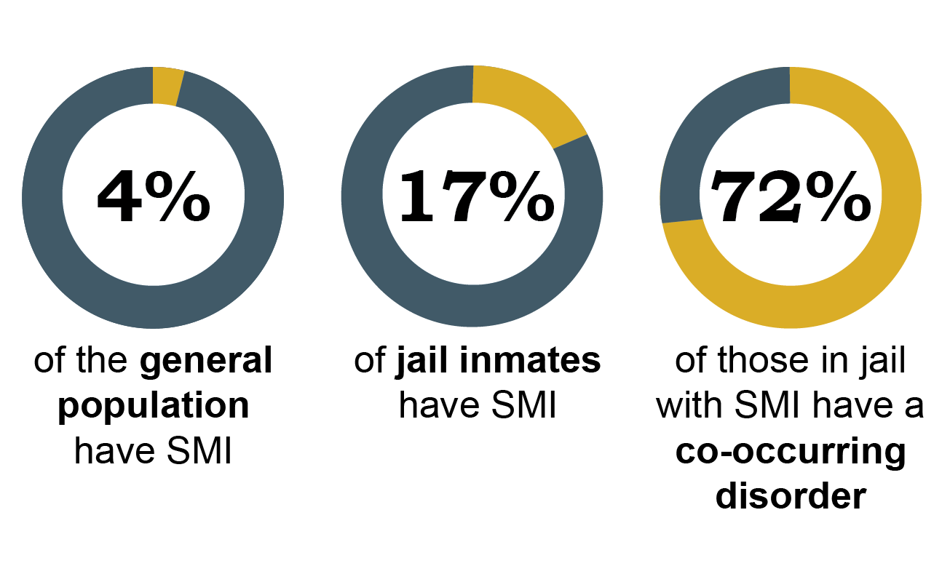
Our Focus Population
Steadman, Osher, Robbins, Case, & Samuels, 2009; Teplin, 1990 Teplin, Abram, & McClelland, 1996; Abram, Teplin, & McClelland, 2003

Slide 4
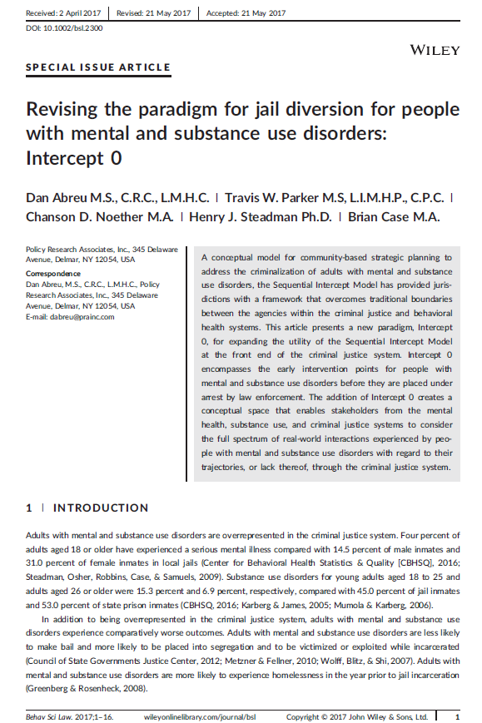
Conceptual Framework
A conceptual framework for communities
For considering interface between criminal justice and behavioral health systems
An organizing tool
Munetz & Griffin 2006; Abreu, Parker, Noether, Steadman, & Case, 2017;
Griffin, et al, eds. 2015

Slide 5
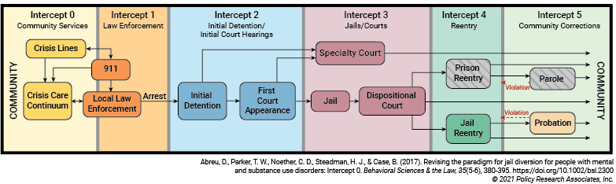
Sequential Intercept Model

Slide 6
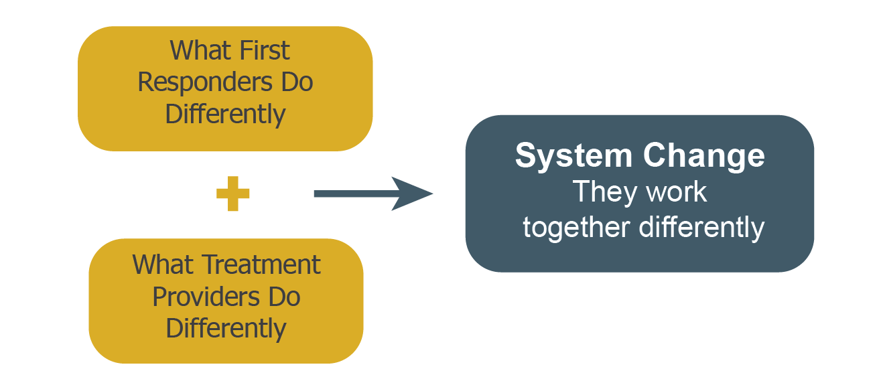
Diversion Equation in Intercepts 0/1

Slide 7
TAKING THE CALL CONFERENCE CO-RESPONDERS
Jan Tokumoto, COO, Frontier Behavioral Health
Sgt. Jay Kernkamp, Spokane Police Department

Slide 8
TRUEBLOOD V. WASHINGTON STATE DEPARTMENT OF SOCIAL AND HEALTH SERVICES
Trueblood is a federal court case regarding the constitutional rights of a class of individuals with disabilities facing prolonged detention in jail awaiting court order competency services by the DSHS ("class members").
Trueblood court-ordered the State of Washington to take immediate steps to reduce the length of time individuals are waiting in jail so that no one is waiting more than 7 days for admission to a hospital for competency services or 14 days for fully completed jail-based competency evaluation.
DSHS was unable to comply with the court’s orders resulting in a contempt order with daily fines levied until parties reached settlement of the contempt issue in late 2018.

Slide 9
CONTEMPT FINES
For the last four years, contempt fines have been used to fund diversion programs across the state.
Grant-funded program developed to divert class members out of the criminal legal system and programs better designed to treat class members’ needs
Four phases to the grant:
Phase i and ii: diversion providers focused on intervening with class members during jail booking as well as jail reentry services
Phase iii: targeted services to crisis response and community supports
Phase iv: recipients are bidding for approximately $20M to provide housing and related residential supports for class members

Slide 10
GOALS OF DIVERSION SERVICES
Prevent deeper class member involvement in and recidivism in the criminal legal system.
Reduce demand for competency services.
Minimize the harm inflicted on class members by reducing criminal legal involvement and long-term incarceration rates.
Serve class members in the least restrictive environment.

Slide 11
CO-RESPONDER CONTRACTS
2018: Contract with DRW for four co-responder teams
Take all calls for service
Access to shelter beds and SUD beds
2019: Contract with WASPC: two co-responders with SPD/two co-responders with the Spokane County Sheriff’s Office
Added Sgt. Kernkamp to oversee all co-responder teams
Boundaryless
Follow-up services provided
Access to assessment for substance use treatment
“Drop and Go” admission to FBH’s Stabilization Unit
Access to FBH/SFD’s co-responder team for community vitals assessment

Slide 12
CO-RESPONDERS
HTTPS://YOUTU.BE/5HJKVWISYZC

Slide 13
COMMUNITY RESOURCES
Diversion/stabilization resources:
House of Charities for one respite bed
Spokane Treatment and Recovery Services (STARS) for secure withdrawal management
Truth Ministries for 10 beds
Access to a substance use disorder professional for immediate assessment for inpatient or outpatient SUD services
“Drop and Go” at FBH Stabilization Unit

Slide 14
TRUEBLOOD RESOURCES
Forensic Projects for Assistance in Transition from Homelessness (FPATH)
Forensic Housing and Recovery through Peer Services (FHARPS)
Outpatient Competency Restoration Program (OCRP)
Mobile Response Unit for Trueblood
Housing Grant: 34 units

Slide 16
911 Triage and Responder Strategy Building the Off Ramp: Quality Connections to Care October 21, 2021

Slide 17
Foundation for Law Enforcement/Behavioral Health Collaborations
Crisis Intervention Team Training—Launched 2009
Focus on diversion and deflection through MacArthur Grant
Civil Code Violations (2016)—shifting from criminal to civil penalties for nuisance behavior
Police-Assisted Diversion (2017)—pre-booking diversion program providing harm-reduction services for people who encounter police for low-level offenses associated with unmet health needs.
Outreach Co-Responder Teams launched in East Division as a targeted intervention for people with opioid use disorder (2019)
Recent shift to earlier interventions…

Slide 18
911 Triage and Responder Strategy
The City of Philadelphia is currently developing a cross-departmental 911 Triage and Responder Strategy that aims to:
Better identify when people are calling 911 in relation to a behavioral health crisis
Expand the range of responder options that are available to meet the needs of the person calling 911 and their family/community
Implement policies and practices that triage 911 calls to the appropriate response option in real time

Slide 19
Current Behavioral Health Crisis Response Continuum Overview
Police-Involved Interventions
Alternatives to Policing
Crisis Intervention Teams (CIT)
Police-Assisted Diversion (PAD)
Co-Responder Teams
Community Outreach Teams (Homeless and CWEU)
Mobile Crisis Teams
Crisis Line De-escalation
EMS-Based Teams
Crisis Stabilization Centers
Case Management Teams
3,000 officers trained
985 social referrals and arrest diversions
250 service connections since Oct 2019
44,692 contacts with 8,990 unique individuals in 2019
2,200 dispatches/ year
50,000- 54,000 calls per year, 80% resolved from call alone
150 service connections since June 2019
9,300 people served/year
5,357 people served in 2018
Expansion Focus Area

Slide 20
911 Triage Reforms
To better identify and triage calls into the 911 Call Center where individuals are experiencing behavioral health crisis
Revised Call-Taker Script to Better Identify Behavioral Health Crisis Calls (approx. 4,000 calls/month)
Modified CIT Training for Call-Takers and Dispatchers for De-escalation
Embedded Behavioral Health Navigator to Assist in Triaging 911 Calls to the Appropriate Responder

Slide 21
NEW PILOT PROGRAM: Crisis Intervention Responder Team (CIRT) Providing a health-centered police response to people in behavioral health crisis
Call-takers in 911 Radio Room identify call with behavioral health need
Dispatchers determine the appropriate responder based on info from call-taker
CIRT Units respond to
individuals in crisis
Patrol officers request support from CIRT Units

Slide 22
Crisis Intervention Responder Team (CIRT) Pilot
Pilot Description
4 CIRT Units (each with an officer and a clinician)
2 Peer Follow-Up Teams
Pilot Zone: East Division & Southwest Division
M–F, 8 a.m.–4 p.m.
CIRT Teams assigned to ROC North & ROC South & detailed to the Service Details
Specialized classroom and field training ongoing
Pilot launch expected late May 2021
x4
CIRT Officer (CIT Trained)
Contracted BH Clinician
x2
Contracted Peer Follow-Up Team

Slide 23
Crisis Expansion
To better connect 911 call center to the city’s crisis system and grow local crisis capacity
Expansion of the Philadelphia Crisis Line & 988 Direct Dial-In
Warm Transfer from 911 to Philadelphia Crisis Line
Mobile Crisis Expansion

Slide 24
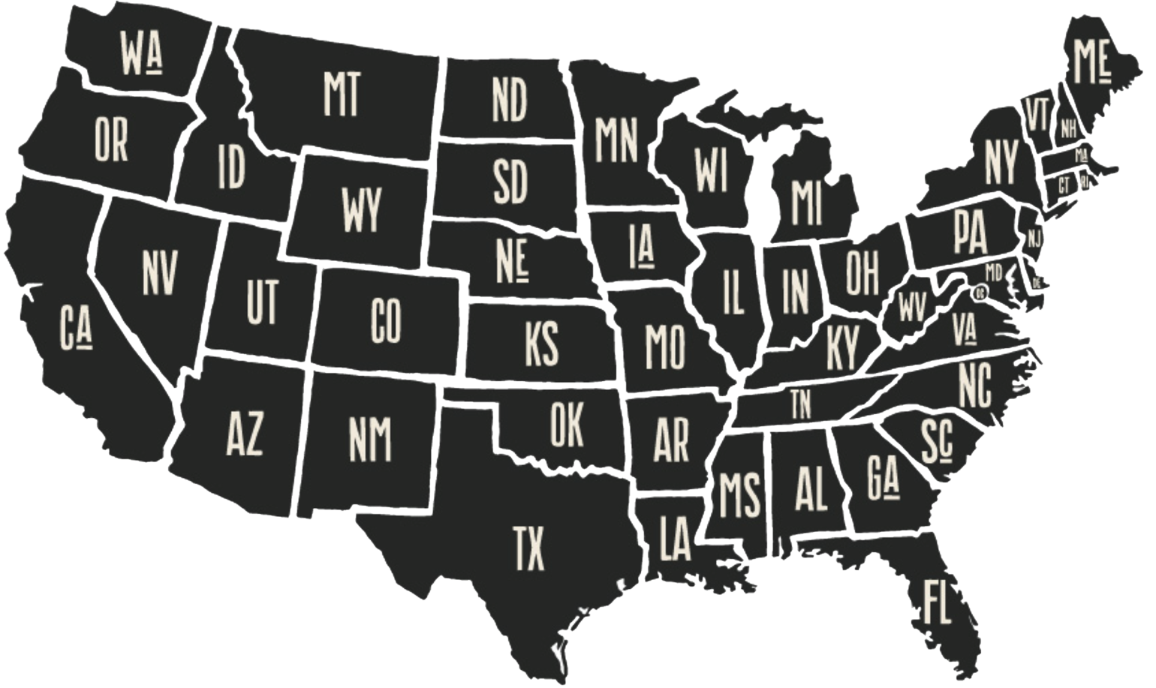
Johnson County, Kansas
KC metro population 2.2 million
Johnson County population 621,000
Notes:
Presenter: Robert

Slide 25
20 cities
17 municipal & county law enforcement agencies
1,100 beds
857 avg. daily population
Notes:
Presenter: Robert

Slide 26
Justice Information Management System (JIMS)
A single database follows each person…
Booking to county jail
DA’s office review
Through entire court process
Onto probation or other supervision

Slide 27
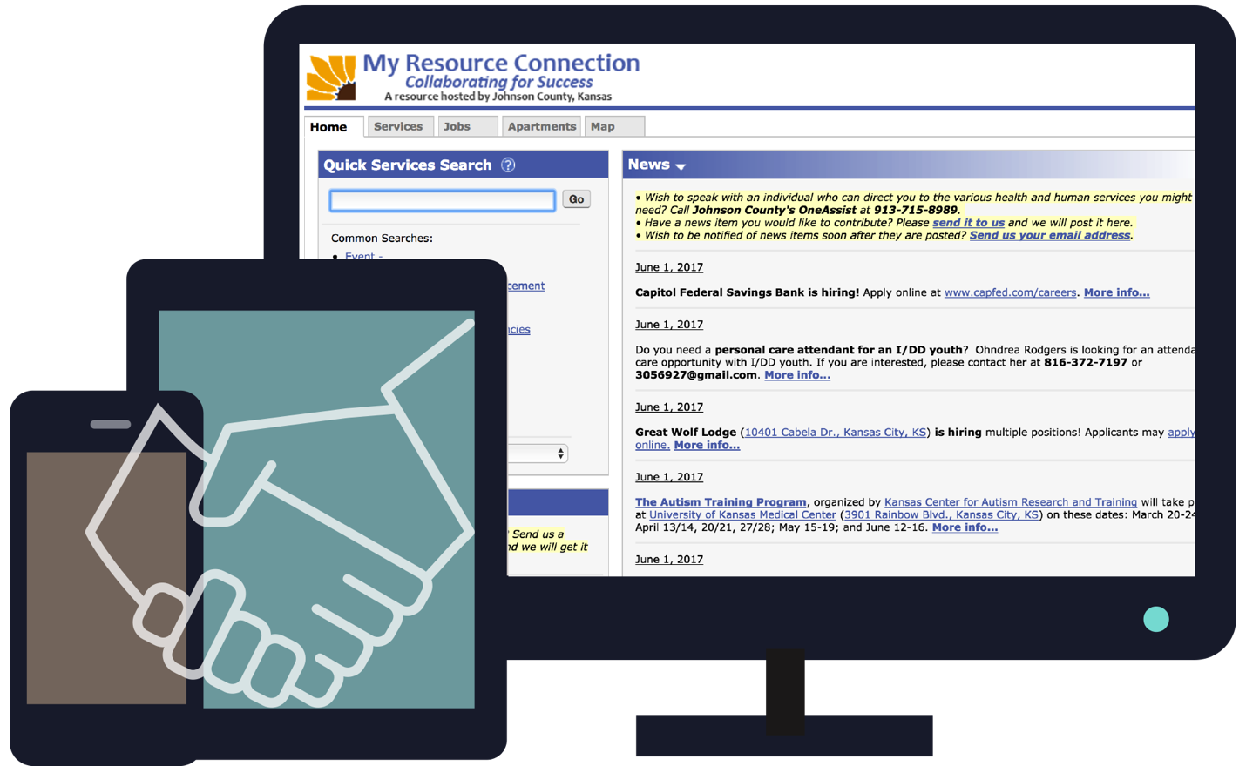
My Resource Connection
Collaborating for Success

Slide 28
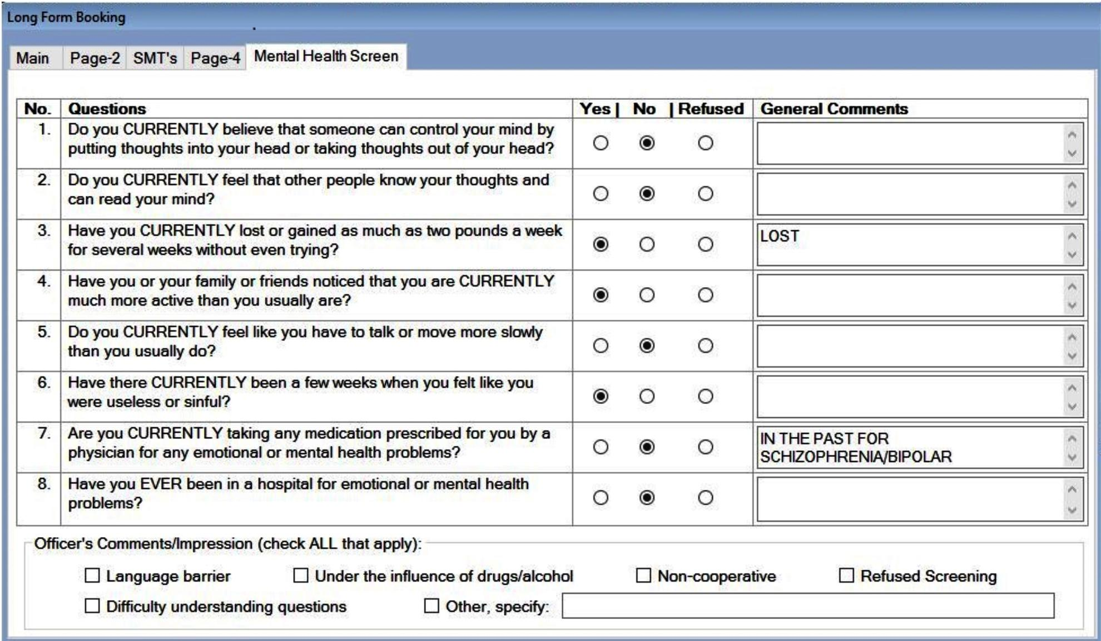
Brief Jail Mental Health Screen
Notes:
Presenter: Rob

Slide 29
Brief Jail Mental Health Screen
We’re able to identify residents who likely struggle
We have opportunity to engage at-risk people
We can
improve the coordination of care
Notes:
Presenter: Rob

Slide 30
Using the
BJMHS to connect
people to effective care

Slide 31
Booking Processes
JIMS sends alerts to Johnson County Mental Health staff daily
Screen results entered in JIMS by the sheriff’s office
Mental health staff look up each person in electronic record

Slide 32
Brief Jail Mental Health Screen Process Flow
Connected
BJMHS
Flagged
Referred for
Outreach
Not
Connected
Not Flagged

Slide 33
Brief Jail Mental Health Screen
Research Question
Does offering mental health treatment for individuals who are screened for mental health issues and released from jail reduce the likelihood they will return? Does it increase their use of mental health services post-release?
Notes:
Presenter: Rob

Slide 34
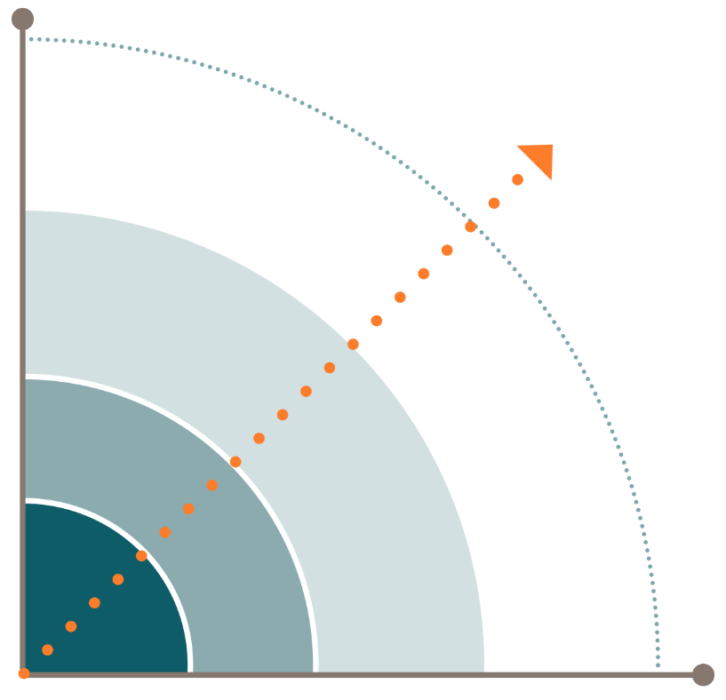
Developed a predictive analytics model to identify people who are most likely to have a police encounter resulting in a jail booking in the next 12 months.

Slide 35
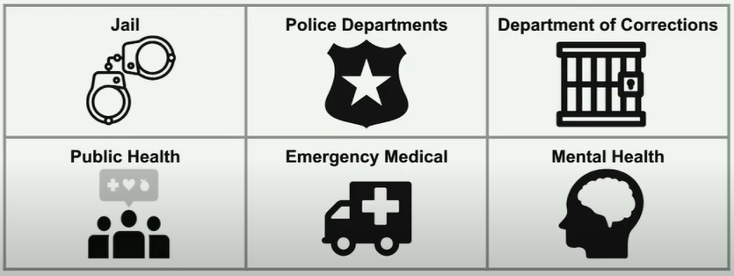
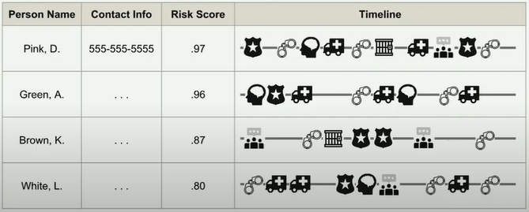

Slide 36
Thank you!
Tim DeWeese, LMSW
Director
Johnson County Mental Health Center
6000 Lamar Ave. Suite 130
Mission, KS 66202
Direct (913) 826-4022
Robert A. Sullivan, Jr.
Director
Department of Corrections
588 E. Santa Fe, Suite 3000
Olathe, Kansas 66061
Direct (913) 715-4525 | Office (913) 715-4524

Slide 37
Thank You!
Risë Haneberg at rhaneberg@csg.org
Felicia Lopez Wright at fwright@csg.org

